Slide 1
Slide and layout guide
Business and Finance

Slide 2
Slide and layout guide
Business and Finance

Slide 3
Table of contents
1 Adding a new slide
2 Changing the layout
3 Customizing a slide
4 Type
5 Graphics

Slide 4
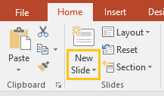
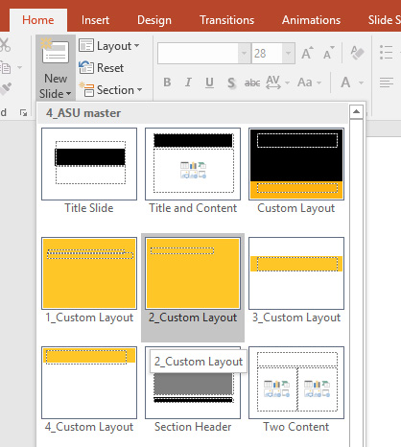
Adding a new slide
Under the Home tab, click the New Slide button and choose the layout you need:

Slide 5
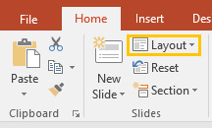
Changing the layout
If you want to change the layout of a slide, simply click the Layout button under the Home tab and choose a new layout:

Slide 6
Consider the following when customizing a slide
Only use Arial for type
No slanted, rotated or stretched text
Only use colors from the ASU palette in the slide master
Applying effects are not recommended

Slide 7
Type
Use Arial for title or heading. Set it to Bold.
Use Arial for body text or descriptions.
Do not italicize, underline, or apply drop shadow or strikethrough on texts.
Do not change the character spacing.
No all-uppercase texts.
Do not apply outlines on texts.

Slide 8
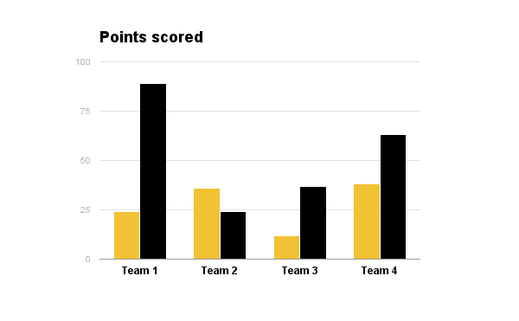
Graphics
Do not obstruct the ASU logo with other elements.
Do not manipulate or edit the logo.
Only use basic animations on elements (Appear or Fade is recommended; no Random Bars or Wheel).
Try to use high-resolution photos for presentation.
Text or Shape Effects are not recommended.

Slide 9
How do we take the creative to the next level?

Slide 10
How do we take the creative to the next level?

Slide 11
How do we take creative to the next level?

Slide 12
How do we take creative to the next level?

Slide 13
Headline
Text goes here
Text goes here too
Text goes here as well

Slide 14
Headline is sentence cased

Slide 15
Get the picture?
Yes, but only with a photo release
brandguide.asu.edu

Slide 16
Example of headline with tables
Activity | Head | Heart | Feet and Hands
Holiday communications | • | ❤
End of year report | •
Digital video | • | ❤
Washington Monthly | •
Gammage Playbill | • | ❤
Phoenix Business Journal | •
AZ Capitol Times | •
Activity | Head | Heart | Feet and Hands
Ranking billboards | •
Campus ranking banners | •
AZ Republic partnership | • | ❤ | >>
Sun Devil Rewards | • | ❤ | >>
Rankins and scholar ads | •
Social media | • | ❤ | >>
Event signage | • | ❤
Activity | Head | Heart | Feet and Hands
Campaign alignment | • | ❤ | >>
Sun Devil Athletics alignment | • | ❤ | >>
ASU Online alignment | • | ❤ | >>
ASU Magazine | • | ❤ | >>
Recruitment alignment | • | ❤ | >>
About site redesign | • | ❤ | >>
Homepage refresh | • | ❤ | >>

Slide 17
Headline here
Only at ASU...

Slide 18
You are all set
Please refer to branding.asu.edu for more in-depth information about the university’s branding standards.
Please feel free to delete these slides. Thank you.

