Slide 1
Planview for Resource Managers: Create Your Project

Slide 2
Agenda
Intro to Planview
Login
Create a Work Portfolio
Create a Resource Portfolio
Grants
Update Resource Attributes
Manage Resources
Fill Out the Timesheet
Manage Estimated vs. Actual Time

Slide 3
Intro to Planview

Slide 4
Intro to Planview
Planview is software that helps you plan projects of any size.
With Planview, you can:
Create projects
Assign people to tasks
Track the financial cost
Monitor progress
Planview gives you a better understanding of (a) cost, (b) timing, (c) impact and (d) work required to complete a project.

Slide 5
Intro to Planview
There are three major types of users in Planview:
Project managers
Resource managers
Team members

Slide 6
Agenda
Intro to Planview
Login
Create a Work Portfolio
Create a Resource Portfolio
Grants
Update Resource Attributes
Manage Resources
Resolve Conflicts
Fill Out the Timesheet
Manage Estimated vs. Actual Time

Slide 7
Login

Slide 8
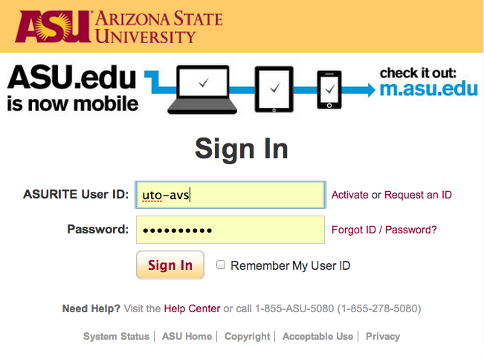
Login: Concept
Request an Account
Email ppmo@asu.edu and request an account.
Login to Production
https://asu.edu/planview
Login with your ASURITE UserID & password

Slide 9
Login: Try It!
Log into the training environment
Visit https://links.asu.edu/pvtrain
Pull down the list of environments and select AUTRAIN
Log in as rm#
Your password is the lowercase version of your username

Slide 10
Agenda
Intro to Planview
Login
Create a Work Portfolio
Create a Resource Portfolio
Grants
Update Resource Attributes
Manage Resources
Fill Out the Timesheet
Manage Estimated vs. Actual Time

Slide 11
Create a Work Portfolio

Slide 12
Create a Work Portfolio: Concept
A work portfolio is a collection of projects.
You can set up as many portfolios as you’d like.
Everyone should have a portfolio containing the projects to which they are connected.

Slide 13
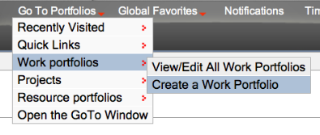
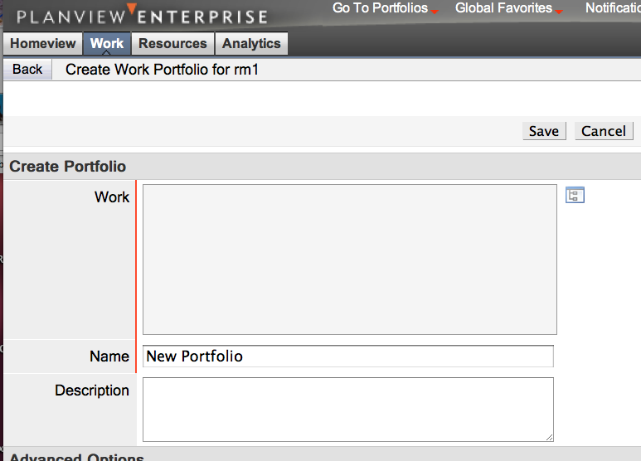
Create a Work Portfolio: Demo

Slide 14
Create a Work Portfolio: Try It!
Set up a work portfolio called Training Projects that shows all projects in the Planning and Program Management Office division.
Set up a second work portfolio that shows all UTO MOB Projects.
Once you have done this, you should see a list of the portfolios you have created.

Slide 15
Agenda
Intro to Planview
Login
Create a Work Portfolio
Create a Resource Portfolio
Grants
Update Resource Attributes
Manage Resources
Fill Out the Timesheet
Manage Estimated vs. Actual Time

Slide 16
Create a Resource Portfolio

Slide 17
Create a
Resource Portfolio: Concept
A resource portfolio lists all of the employees that you manage.
You can create a resource portfolio where you select specific people, or you can create a resource portfolio for a specific group within UTO.
Please note that new employees and/or employees who no longer work at ASU must be manually added or removed from Planview. The system does not sync with PeopleSoft at this time. Email ppmo@asu.edu or submit a ticket to the Planview Issue Support project within Jira as your group changes.
Notes:
Please note that groups read Planview data, not PeopleSoft data. So if someone leaves or is added to that group, this will not be reflected in your resource portfolio.
Emphasize that you can add anyone in the org to your resource portfolio.

Slide 18
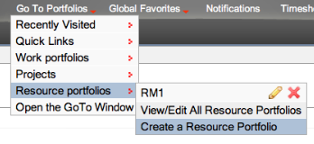
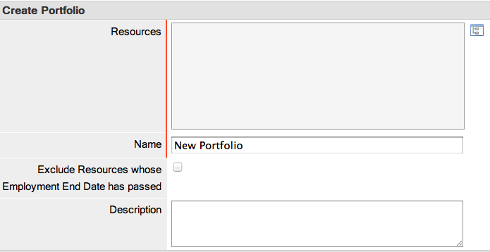
Create a
Resource Portfolio: Demo

Slide 19
Create a Resource Portfolio: Try It!
Name your new portfolio Resource Manger #.
Navigate to Department: Training, select Division: Section # and select Resource Manager # in the right hand field.

Slide 20
Agenda
Intro to Planview
Login
Create a Work Portfolio
Create a Resource Portfolio
Grants
Update Resource Attributes
Manage Resources
Fill Out the Timesheet
Manage Estimated vs. Actual Time

Slide 21
Grants

Slide 22
Grants: Concept
A grant helps ensure that only appropriate users have access to a specific work item, resource, contract, strategic entity, or service. There are work, resource, contract, strategic, and service grants. The ones we will be concerned with are work and resource grants.
Each user is given grants to provide access to data related to work and resources. These grants provide the system security allowing each user access to perform their work.
Notes:
After a PVA establishes the initial grants, users may review their own grants as well as share their access with other users by creating new grants. Before doing so, a user should be aware of the following information:
Grants are applicable to projects, resources, contracts, strategies, and services but not portfolios
Grants can be defined at the lowest level of a structure or at any parent
A grant created at a parent includes a grant to not only the entity associated with that grant but to all of the parent's children in the structure as well
A user may create grants for other users on any entity where that user has a grant or any child of such an entity
Planview ignores resource grants more than one level above the work item associated with the grant
A grant is inherited by all children in a resource structure

Slide 23
Grants: Concept
Resource grants allow a resource manager to approve requests for work done by their employees.
Everyone has read-only work grants to all projects in the system, which allows you to view any project. Project managers have read-write access to the projects they are managing. Project managers can grant read-write access to other people in the system.
If your grants are incorrect, email ppmo@asu.edu or submit a ticket to the Planview Issue Support project within Jira.
Notes:
RESOURCE GRANTS
Managed by PV admins in PPMO Office
Restrict forwarding automatic
Must get PPMO Office to allow someone else to manage a resource in the event of vacation, sick leave, etc.
WORK GRANTS
Used to edit tasks in a project
Employees are able to give work grants to co-workers
Restrict forwarding optional
After a PVA establishes the initial grants, users may review their own grants as well as share their access with other users by creating new grants. Before doing so, a user should be aware of the following information:
Grants are applicable to projects, resources, contracts, strategies, and services but not portfolios
Grants can be defined at the lowest level of a structure or at any parent
A grant created at a parent includes a grant to not only the entity associated with that grant but to all of the parent's children in the structure as well
A user may create grants for other users on any entity where that user has a grant or any child of such an entity
Planview ignores resource grants more than one level above the work item associated with the grant
A grant is inherited by all children in a resource structure
Summary slide: PM, RM, TM can do these things…
PMs can forward their work grants

Slide 24
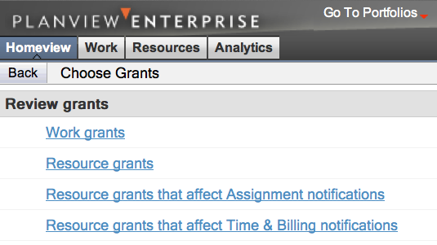
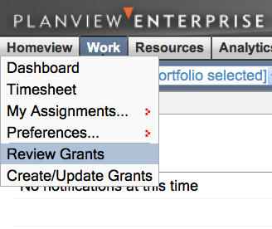
Grants: Demo (Review Grants)

Slide 25
Grants: Try It! (Review Grants)
Review the different grants in the Planview training environment.
Notes:
PAT: Will UTO RMs have read/write work grants to their MOB projects?
If they will, then we need training database set up in same way.
Many will have both RM/PM role, so they would have read/write access to MOB projects as a PM, but only as a PM.
If not a PM, then they would not have read/write work grants to their MOB projects.

Slide 26
Agenda
Intro to Planview
Login
Create a Work Portfolio
Create a Resource Portfolio
Grants
Update Resource Attributes
Manage Resources
Fill Out the Timesheet
Manage Estimated vs. Actual Time

Slide 27
Update Resource Attributes

Slide 28
Update
Resource Attributes: Concept
A resource manager confirms the employee’s job title and identifies the employee’s resource role(s). Each employee can identify their own skills in Planview.
If you cannot find the attribute you are looking for, please email ppmo@asu.edu or submit a ticket to the Planview Issue Support project within Jira.
Notes:
Can change job title if they choose from Data Picker list
Can identify up to three roles

Slide 29
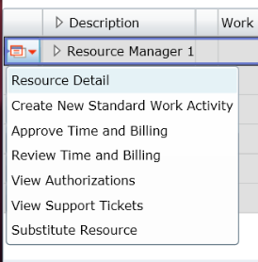
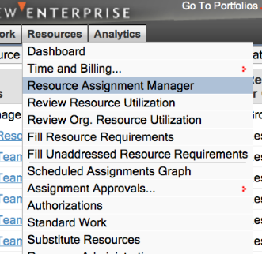
Update Resource Attributes: Demo (Identifying Resource Roles)

Slide 30
Update Resource Attributes: Try It!
Enter the Resource Assignment Manager and assign a UTO resource role to each Team Member.

Slide 31
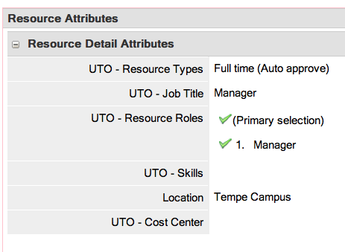
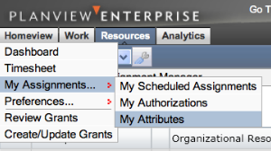
Update Resource Attributes: Demo (Identifying Your Skills)

Slide 32
Update Resource Attributes: Try It!
Enter the Planview training environment and select five skills that describe your abilities in UTO.
Rank your skills in order, with 1 being most proficient.

Slide 33
Agenda
Intro to Planview
Login
Create a Work Portfolio
Create a Resource Portfolio
Grants
Update Resource Attributes
Manage Resources
Fill Out the Timesheet
Manage Estimated vs. Actual Time

Slide 34
Manage Resources

Slide 35
Manage Resources: Concept
Now you will learn how your resources are assigned to projects. You’ll also learn the differences between Projects, Maintenance of Business (MOB) and Standard Work Activity.
Some of the tasks you will practice include:
Requiring resources for your project
Reserving resources for your project
Allocating resources for your project
Authorizing resources for your project

Slide 36
Manage Resources: Concept
Projects: Have start and end dates, have planned out tasks assigned to individuals
Maintenance of Business (MOB): Projects for operations and care activities, ongoing, dynamic, don’t plan down to the individual task level (such as server maintenance, faculty support, website updates)
Standard Work Activities: Vacation, sick leave & administrative duties (like staff meetings)

Slide 37
Manage Resources: Concept
How PMs Apply Resources to Projects: There are many ways that resources (people) can be applied to tasks:
Requirements
Reservations
Allocations
Authorizations
Standard Activities
Maintenance of Business
Notes:
Requirements – Indicate the need for a type of resource based on a role or skill, along with the providing organization. Used for long term planning at a high level (e.g., project or phase). Requirements can be refined with multiple attributes (e.g., role, skill, location, specific resource, contractor/employee, etc.).
Reserves –Used to block off an individual resource’s availability to work on designated project or non project work. Used in a matrixed environment by a resource manager to permit a project manager to use a resource, or to block off time for support work. May also be referred to as soft booking. When requesting resources, it is usually most effective to request at the highest reasonable level of the WBS to provide more flexibility later when assigning to specific tasks. Work owners with read-write authority to resources, also use reserves to block off resources’ time for projects to assist in tracking their future work load.
Allocations – Specific task assignments and effort estimates for named individuals created at the lowest used planning level of the WBS. May also be referred to as hard booking.
Authorizations – Group or individual assignment to any level of the WBS from the primary planning level or below. No level of effort can be specified therefore the resource profiles are not affected by authorizations.
Standard Activities - Provides a means to record non-project time such as vacation, illness, holidays, etc. In some cases, these non-project work situations are often unplanned, such as illness. Scheduling known non-work time is helpful in determining overall capacity.
Initiatives – Initiatives are projects (typically about support activities, “Server support” for example) where people can log time against these types of work as part of their work week.

Slide 38
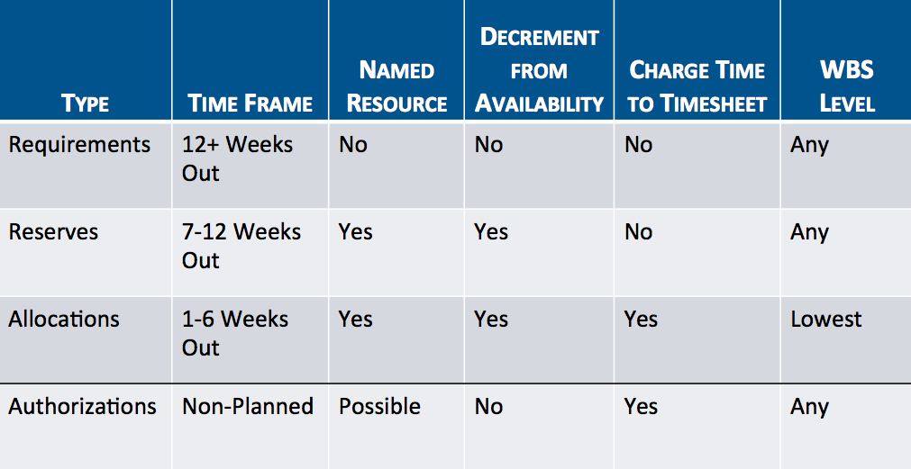
Manage Resources: Concept
Notes:
Requirements – Indicate the need for a type of resource based on a role or skill, along with the providing organization. Used for long term planning at a high level (e.g., project or phase). Requirements can be refined with multiple attributes (e.g., role, skill, location, specific resource, contractor/employee, etc.).
Reserves –Used to block off an individual resource’s availability to work on designated project or non project work. Used in a matrixed environment by a resource manager to permit a project manager to use a resource, or to block off time for support work. May also be referred to as soft booking. When requesting resources, it is usually most effective to request at the highest reasonable level of the WBS to provide more flexibility later when assigning to specific tasks. Work owners with read-write authority to resources, also use reserves to block off resources’ time for projects to assist in tracking their future work load.
Allocations – Specific task assignments and effort estimates for named individuals created at the lowest used planning level of the WBS. May also be referred to as hard booking.
Authorizations – Group or individual assignment to any level of the WBS from the primary planning level or below. No level of effort can be specified therefore the resource profiles are not affected by authorizations.
Standard Activities - Provides a means to record non-project time such as vacation, illness, holidays, etc. In some cases, these non-project work situations are often unplanned, such as illness. Scheduling known non-work time is helpful in determining overall capacity.
Initiatives – Initiatives are projects (typically about support activities, “Server support” for example) where people can log time against these types of work as part of their work week.

Slide 39
Manage Resources: Concept (Resolve Conflicts)
Sometimes resources are overbooked.
As a Resource Manager, you can identify when this occurs so that you can discuss it with the Project Manager to resolve such conflicts.
Notes:
TRAINING DATABASE: It would be nice if we could show 15 resource requests for each student – Requirements, Reservations, Allocations & Authorizations
QUESTION: What does a resource manager do when they review their notifications but don’t see start and end dates / other data (in the past)? What happens when it’s in the near future? What happens if you’re in the middle, between the start and end dates?

Slide 40
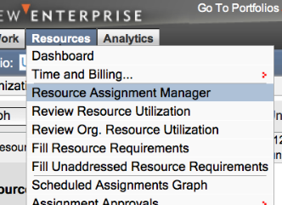
Manage Resources: Demo (Resolve Conflicts)
Notes:
TRAINING DATABASE: It would be nice if we could show 15 resource requests for each student – Requirements, Reservations, Allocations & Authorizations
QUESTION: What does a resource manager do when they review their notifications but don’t see start and end dates / other data (in the past)? What happens when it’s in the near future? What happens if you’re in the middle, between the start and end dates?

Slide 41
Manage Resources: Try It!
Go to the Resource Assignment Manager and review and approve your resource requests.
Identify and resolve any conflicts with your team members by:
Deny a request
Substitute a resource
Notes:
TRAINING DATABASE:
It would be nice if we could show 15 resource requests for each student – Requirements, Reservations, Allocations & Authorizations
Need at least 1 MOB in training database
Resource managers have to have work grants to authorize resources to the MOBs
QUESTION: What does a resource manager do when they review their notifications but don’t see start and end dates / other data (in the past)? What happens when it’s in the near future? What happens if you’re in the middle, between the start and end dates?
If they are in the past, you can manually enter start and end time to clear them from your list
Dashboard > Needs Approval > Manage Resources > Reserve Request for whoever it is > shows work breakdown structure > Reserve Detail > Shows start and end dates > Can then approve request to clear off past ones.

Slide 42
Manage MOBs

Slide 43
Manage MOBs: Concept
Maintenance of Business includes projects for operations and care activities. These tasks are ongoing and dynamic; they are those activities in which you don’t plan down to the individual task level, such as server maintenance, faculty support, and website updates.
Resource Managers can authorize resources to record time worked on Maintenance of Business projects. Resource managers that are the owners of a MOB can also allocate resources to that project.
Please note that this does not decrement their availability.
Notes:
TRAINING DATABASE:
It would be nice if we could show 15 resource requests for each student – Requirements, Reservations, Allocations & Authorizations
Need at least 1 MOB in training database
Resource managers have to have work grants to authorize resources to the MOBs
QUESTION: What does a resource manager do when they review their notifications but don’t see start and end dates / other data (in the past)? What happens when it’s in the near future? What happens if you’re in the middle, between the start and end dates?
If they are in the past, you can manually enter start and end time to clear them from your list
Dashboard > Needs Approval > Manage Resources > Reserve Request for whoever it is > shows work breakdown structure > Reserve Detail > Shows start and end dates > Can then approve request to clear off past ones.

Slide 44
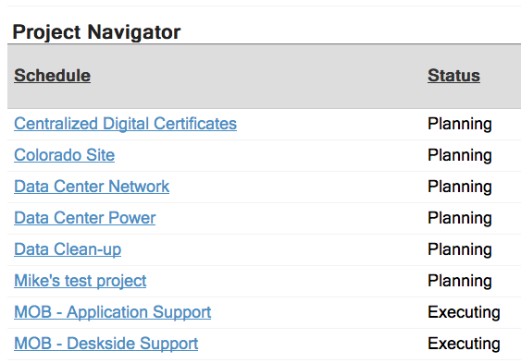
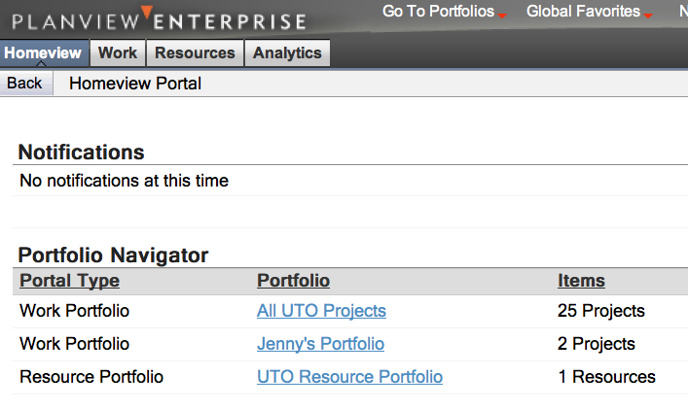
Manage MOBs: Demo
Notes:
SHOW THESE THINGS
Approve requested resources
Authorize people to do MOB work
Monitor resource utilization

Slide 45
Manage MOBs: Try It!
Find MOB-rm#, and in that same project authorize a resource to perform MOB work.
Allocate a resource to perform MOB work in the same project.
Notes:
TRAINING DATABASE: It would be nice if we could show 15 resource requests for each student – Requirements, Reservations, Allocations & Authorizations
QUESTION: What does a resource manager do when they review their notifications but don’t see start and end dates / other data (in the past)? What happens when it’s in the near future? What happens if you’re in the middle, between the start and end dates?

Slide 46
Manage Standard Activities

Slide 47
Manage
Standard Activities: Concept
Standard Activities include vacation, sick leave and administrative duties (like staff meetings).
Every individual should enter their own standard activities into their timesheet; however, resources managers can also do this for their resources.
Notes:
TRAINING DATABASE: It would be nice if we could show 15 resource requests for each student – Requirements, Reservations, Allocations & Authorizations
QUESTION: What does a resource manager do when they review their notifications but don’t see start and end dates / other data (in the past)? What happens when it’s in the near future? What happens if you’re in the middle, between the start and end dates?

Slide 48
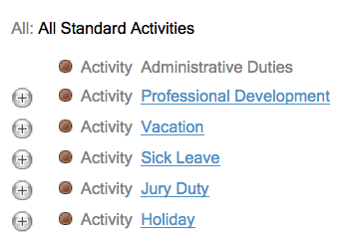
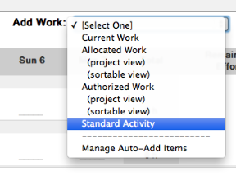
Manage
Standard Activities: Demo
Notes:
Demo 1: Adding Standard Activities to your own timesheet
Demo 2: Using RAM to add Standard Activities to one of our resources.

Slide 49
Manage
Standard Activities: Try It!
Go add Standard Activities to your timesheet.
Use the Resource Assignment Manager to add Standard Activities to one of your resources.

Slide 50
Agenda
Intro to Planview
Login
Create a Work Portfolio
Create a Resource Portfolio
Grants
Update Resource Attributes
Manage Resources
Fill Out the Timesheet
Manage Estimated vs. Actual Time

Slide 51
Fill Out the Timesheet

Slide 52
Fill Out the Timesheet: Concept
Depending on your department’s business procedures, you and your staff may be required to document the number of hours spent on project work and standard activities.

Slide 53
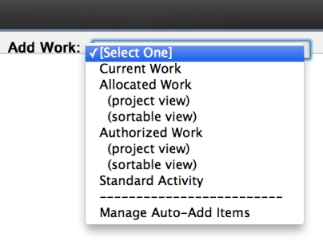
Fill Out the Timesheet: Demo

Slide 54
Fill Out the Timesheet: Try It!
Build a timesheet that includes standard activities, administrative duties, project work and maintenance of business.
Go to the Resource Assignment Manager and fill out a timesheet for one of your team members.

Slide 55
Agenda
Intro to Planview
Login
Create a Work Portfolio
Create a Resource Portfolio
Grants
Update Resource Attributes
Manage Resources
Fill Out the Timesheet
Manage Estimated vs. Actual Time

Slide 56
Manage Estimated vs. Actual Time

Slide 57
Manage Estimated
vs. Actual Time: Concept
Being able to monitor the work your resources actually perform compared to the requested time from Project Managers is an important task.
Over time, this function will allow UTO to better estimate the amount of time it will take to perform tasks.

Slide 58
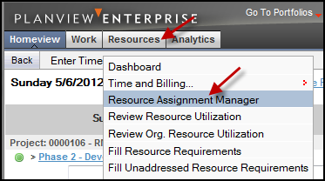
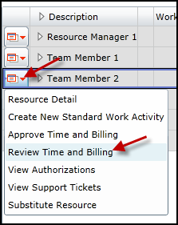
Manage Estimated
vs. Actual Time: Demo

Slide 59
View Actual Time: Try It!
Go into the Resource Assignment Manager and view your team members’ actual time.

Slide 60
Get Help
Email ppmo@asu.edu
Check the website for FAQs: http://links.asu.edu/ppmo
Ongoing Training & Information
https://www.planviewprisms.com
Separate ID and password (free) required

