Slide 1
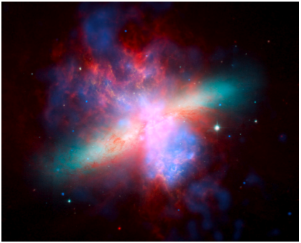
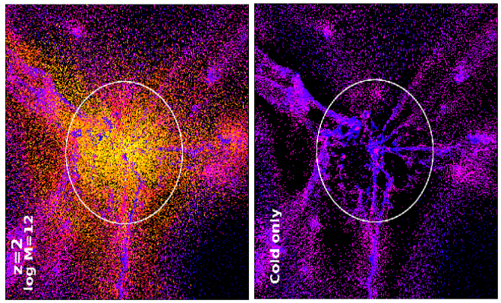
Keeping (Better) Track of the Universe’s Baryons
Gas goes in…
…gas comes out.
Jacqueline Monkiewicz
AST 591, Sept. 24, 2010

Slide 2
Talk Structure:
2010 Decadal Review, Panel Report:
“Galaxies Across Cosmic Time”
Intro to cosmic SF history & missing baryon problem.
Keres et al. 2005 (ApJ )
“How Do Galaxies Get Their Gas?”
Observational possibilities in the upcoming decade?

Slide 3
Decadal Survey Panels:
Science Frontiers (5 panels):
Identify important themes & opportunities for next decade
Describe scientific context
Describe key observation & theory advances necessary
Weigh above to call out 4 central questions
Program Prioritization (4 panels):
Refer to above recommendations
Report on recent & ongoing advances
Preview & compare upcoming projects
Assess construction costs & risks
Compare small vs. large projects
Prioritize upcoming research programs

Slide 4
Decadal Survey Panels:
Science Frontiers:
Cosmology & Fundamental Physics
Galactic Neighborhood
Galaxies Across Cosmic Time
Planetary Systems & Star Formation
Star & Stellar Evolution
Program Prioritization:
EM Observations from Space
Optical & IR Observations from the Ground
Particle Astrophysics & Gravitation
Radio, mm, & submm Observations from the Ground

Slide 5
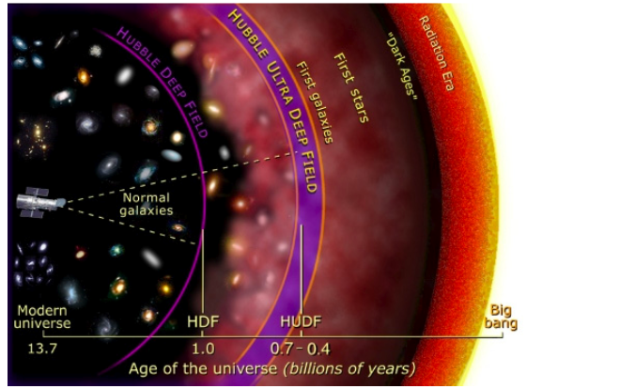
Galaxies Across Cosmic Time:
Meg Urry, Mitchell Begelman, Andrew Baker, Neta Bahcall, Romeel Davé, Tiziana di Matteo, Henric Krawczynski, Joseph Mohr, Richard Mushotzky, Chris Reynolds, Alice Shapley, Tommaso Treu, Jacqueline van Gorkom, Eric Wilcots

Slide 6
Galaxies Across Cosmic Time:
4 Key Questions:
How do cosmic structures form and evolve?
How do baryons cycle in & out of galaxies, and what do they do while they are there?
How do giant black holes grow, radiate, and influence their surroundings?
What were the 1st objects to light up the Universe, and when?

Slide 7
Galaxies Across Cosmic Time:
4 Key Questions:
How do cosmic structures form and evolve?
How do baryons cycle in & out of galaxies, and what do they do while they are there?
How do giant black holes grow, radiate, and influence their surroundings?
What were the 1st objects to light up the Universe, and when?
Area of Unusual Discovery Potential!

Slide 8
How Do Baryons Cycle In and Out of Galaxies?
How do galaxies acquire gas across cosmic time?
What processes regulate the conversion of gas to stars as galaxies evolve?
How are the chemical elements created and distributed?
Where are the baryons as a function of redshift?
That’s a lot of bulleted lists . Let’s break this down…

Slide 9
How Do Baryons Cycle In and Out of Galaxies?
Gas goes in…
…gas comes out.

Slide 10
How Do Baryons Cycle In and Out of Galaxies?
Gas goes in…
…gas comes out.
(Why is Jackie so obsessed with gas?)

Slide 11
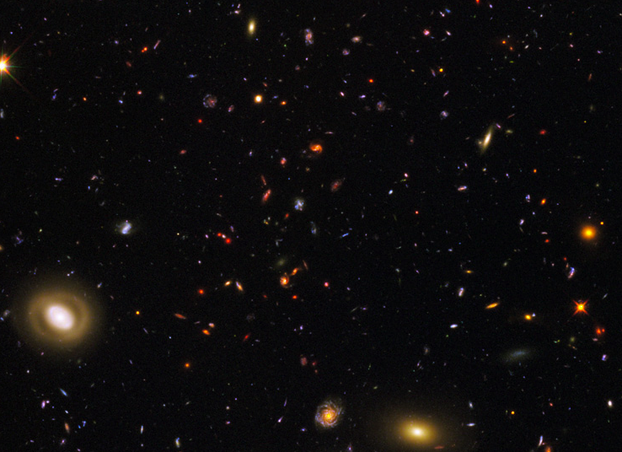
Intro to Cosmic Baryons:
Section of WFC3 Early Release Data (Windhorst, McCarthy, O’Donnell, WFC3 Sci. Oversight Com.)

Slide 12
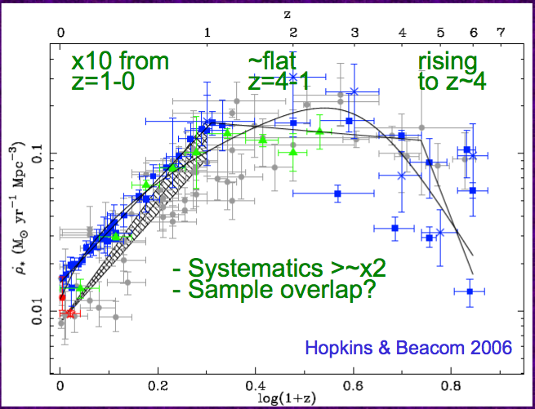
“Madau“ plot:
(Star Formation over cosmic time)

Slide 13
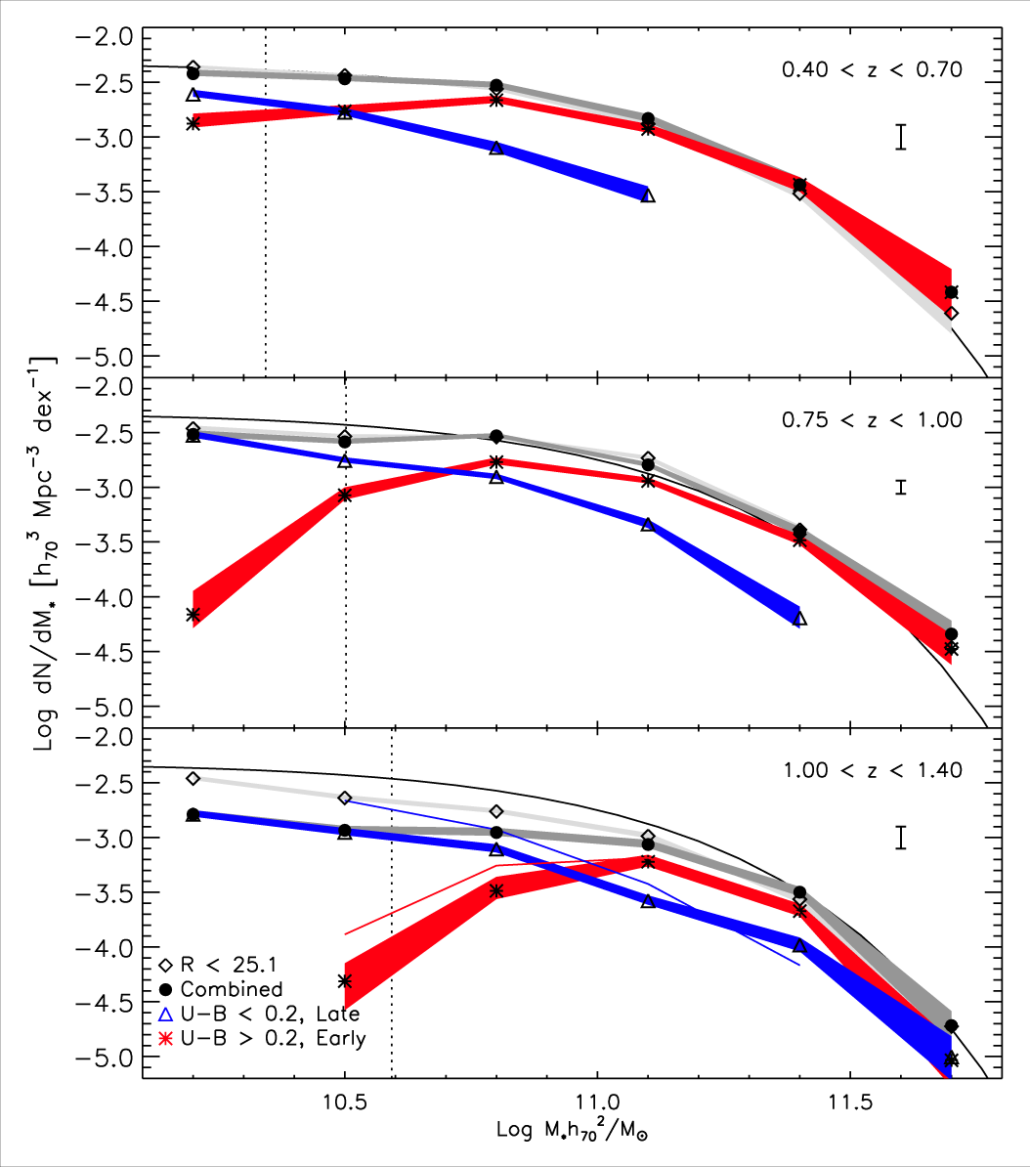
Downsizing:
At z = 0, most SF takes place in much smaller galaxies than it did at z = 2.
Cannot be completely explained by:
Cluster environment
AGN quenching
Mergers
Number Density
Bundy, 2007
Mass

Slide 14
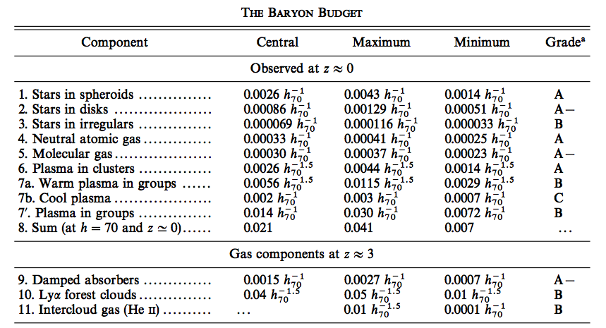
State of the Art 1 Decade Ago:
Fukugita, Hogan & Peebles (1998):

Slide 15
Fukugita, Hogan & Peebles 1998 (con’t):
“Most baryons today are still in the form of ionized gas, which contributes a mean density uncertain by a factor of about 4.”
“Stars and their remnants are a relatively minor component, comprising … only about 17% of the baryons.”
“The formation of galaxies and of stars within them appears to be a globally inefficient process.”
Ω_{b} = 0.021
(0.007 < Ω_{b} < 0.04)
Ω_{b} = 0.046 +/- 0.002
(ΛCDM)
vs.
Conclusion:
“The central value agrees with the prediction from the theory of light element production… This apparent concordance suggests that we may be close to a complete survey of the major states of the baryons.”

Slide 16
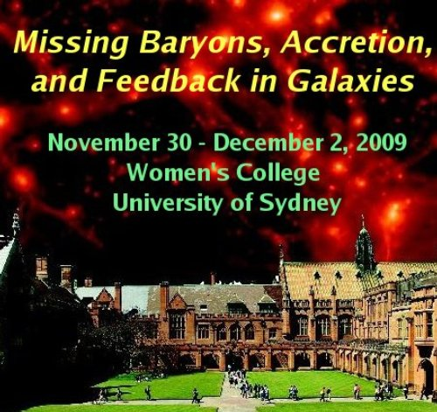
State of the Art 1 Year Ago:

Slide 17
Bregman 2007, ARAA
(slide stolen from M. Pettini’s summary talk)

Slide 18
(slide also stolen from M. Pettini’s summary talk)

Slide 19
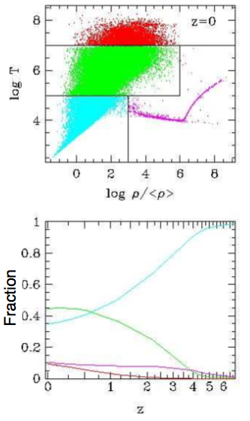
Warm-hot Intergalactic Medium
(WHIM)
T = 10⁵⁻⁷ K
Shock-heated to virial temps of galaxy haloes
Predicted to be ~45% of baryons at z = 0
Nigh-invisible!
Too cool to detect in X-ray
Too diffuse to emit optical
Cen & Ostriker 1999
Dave et al. 2001

Slide 20
Warm-hot Intergalactic Medium
(WHIM)
Hard to get this stuff to cool onto galaxy disks
Collects in galaxy haloes
T = 10⁵⁻⁶ is virial temp
Makes it hard for cooler gas to reach galaxy disks.
Which raises the question..

Slide 21
“How do Galaxies Get Their Gas?”
D. Keres, N. Katz, D. Weinberg & R. Dave
2005, MNRAS, 363, 2
Er, good question!
Kennicutt-Schmidt law:
Stars form from molecular gas
Molecular gas runs out after 1-2 Gyr?
Neutral gas in damped Lyman-alpha absorbers
Not enough of that, either
Need to pull in AND COOL ionized gas

Slide 22
“How do Galaxies Get Their Gas?”
D. Keres, N. Katz, D. Weinberg & R. Dave
2005, MNRAS, 363, 2
BUT:
Ionized gas should shock to halo viral temp
T → 10⁶ K (Fall & Efstathiou 1980)
NOT GOOD FOR FORMING STARS
Spherically symmetric collapse
(Birnboim & Dekel 2003)
→ Shock needs pressure support
→ No shock in low mass halos
( M_{DM} < 10¹¹ M_{sol} )

Slide 23
“How do Galaxies Get Their Gas?”
D. Keres, N. Katz, D. Weinberg & R. Dave
2005, MNRAS, 363, 2
(See also Keres et al. 2009, “Cold mode and hot cores”, MNRAS, 395, 160)
SPH simulations:
TREESPH (GADGET-2)
Cube L = 22.2 h⁻¹ Mpc 50 h⁻¹ Mpc
Particles N = 2 x 128³ 2 x 288³
Resolution M_{res} = 6.8 x 10⁹ M_{sol} 9 x 10⁷ M_{sol}

Slide 24
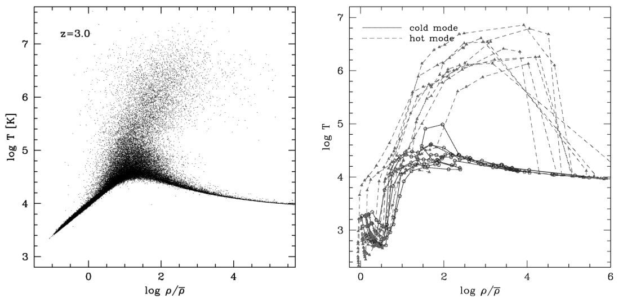
Three distinct phases
Lyman alpha forest
T = 10⁴ K gas in galaxies
T > 10⁵ K shocked gas
Plotting trajectories of accreted galaxies from z = 14.9 → 3, see
some particles never shock

Slide 25
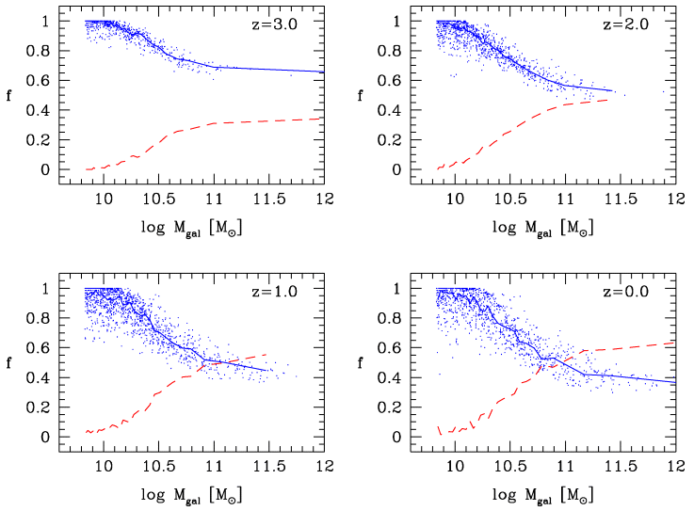
Total contribution of accreted hot & cold mode:
Hot mode dominates larger galaxies at low z

Slide 26
Results:
Hot mode dominates larger galaxies at low z
Smooth transition of mode with mass
Transition mass function of redshift
But cold mode still present in all galaxies at all
redshifts
Effect of filaments?
Caveats:
UV background affects filament cooling times
Mergers contributions? (see Keres 2009)
GADGET-2
Better entropy & energy conservation
Less cooling of accreted hot gas

Slide 27
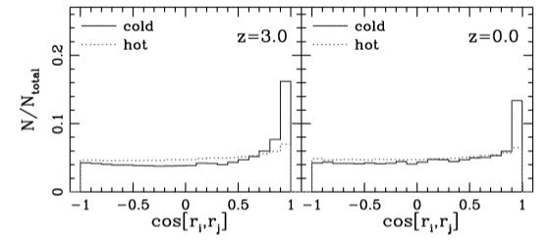
Filamentary Structure:
Accreting particle i at radius r_{i}^{g} from galaxy g
cos [r_{i} r_{j}] → sum vector products of all pairs
Particle pairs are aligned in filaments

Slide 28
Summary:
Cold mode accretion
Gas accretes at T = 10⁴⁻⁵ K
Filamentary inflow, doesn’t shock heat to virial temp
Dominates at high z
→ Explains observed SF ~ M_{* relation}
Still dominant mode of accretion in small galaxies at z = 0
Hot mode accretion
Shock-heated, diffuse gas accretes at T > 10⁵⁻⁷ K
Dominates at low z
Hot cores quench star formation in large haloes
→ Downsizing, reduced SF at late times

Slide 29
The future is exciting! People! GET EXCITED.
Simulations:
Interaction between feedback/outflows and inflows
“Wind mode” -- Galaxies recycle!
Stuff I don’t even know about because theory really ain’t my forte
Gas goes out…
…and goes right
back in?

Slide 30
Absorption-Line Observations!
At z > 1.5 probe rest-UV with optical/IR
→ HI, CIV, OVI and SIV transitions
At z < 1.5, these migrate to UV
→ need high-res 4m UV space capability
→ integral-field UV spectroscopy = EVEN BETTER
Present epoch: most is WHIM
→ OVII, OVIII and CV, CVI soft X-ray transitions
→ need great collecting area for X-ray telescopes
In May 2010 Chandra detected WHIM associated with the “Sculptor Wall” along a QSO sightline

Slide 31
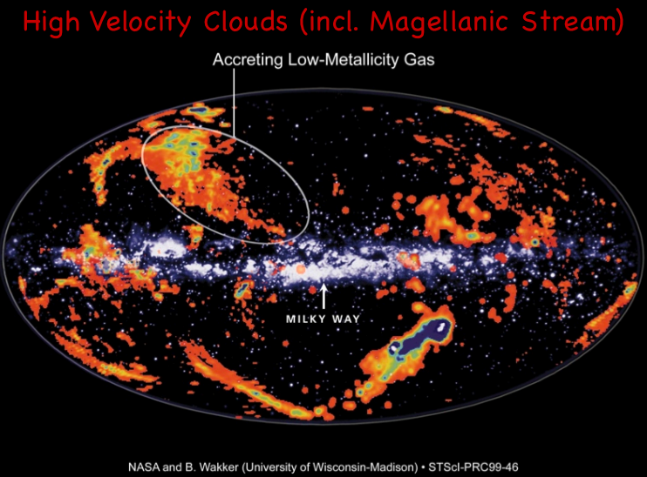
Have we already seen cold mode accretion?
Dijkstra & Loeb (2009) claim Lyman-alpha “blob” may be
T = 10⁴⁻⁵ K inflowing gas.
→ Need higher sensitivity
→ Need better resolution to verify filamentary structure
Milky Way’s high-velocity clouds (HVCs) are likely either “wind” mode or cold mode?

