Slide 1
The Science of JWST
Caleb Wheeler

Slide 2
Table of Contents
First Paper
Second Paper
Nervous standing after I finish early and everyone is too bored to formulate any questions
Pity clapping
Notes:
Both papers have different styles and I adapted to each one of them in a different way. Don’t pet a cat backwards.
Rogier’s Paper is Figure driven Bromm’s Paper is organized by subheading.
Bonus point to the person who can point out the most spelling and grammar errors in this talk.

Slide 3
How JWST can measure first light, reionization and galaxy assembly
R.A. Windhorst, S.H. Cohen, R.A. Jansen, C Conselice, H. Yan
The purpose of this paper is to inform people of the importance of keeping JWST a scientific priority.
Notes:
I made a guess at what the purpose of this paper is. Lucky I have no fear of being completely wrong.

Slide 4
First Light
Refers to the light produced by the first stars in the universe.
These first stars are called population III stars.
Enriched from the remnants of the first stars, population II stars formed.
The population II stars and the black holes left behind by the Population III stars form the first galaxies.
Notes:
Thought to occur at red shifts as high as z(25 – 15) or 130 to 270 million years after the big bang.
Population III stars are thought to be between 200-300 solar masses and are composed out of the primordial elements (why?). These stars were short lived but enriched the the universe with the first heavy elements. These elements allowed for the cooling and collapse gas cloud.
Population star may not have formed for some after the population III because the ISM may have been to heated for the Pop II gas clouds to collapse.
First galaxy formation though to be at z (10 -6) 480 to 950 million year after the big bang.

Slide 5
Reionization
As the early universe expanded, the photon background was redshifted enough for neutral hydrogen to form.
After first light, the universe was repopulated with UV photons capable of ionizing neutral hydrogen.
While the radiation background of space was much less then the ionization energy of hydrogen, the recombination rate was less then ionization rate.
The universe thus became ionized for the second time.
Notes:
The recombination rate was low due to the large mean free path of of electrons, due to the low density of partials, due to the expansion of the universe

Slide 6
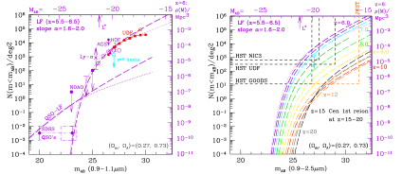
First Light detection and Reionization by JWST
Detection up 31.5 m_{ab} using 7 filters for different redshifts over 0.4 years of observation.
Notes:
Absolute Magnitude = m_(ab) Talk about the Units on the x and y axis
Part a: Predicted luminosity functions and constraints by different surveys. Note the quasar Luminosity Function compared the that of one produced by dwarf galaxies. The observed data follows the projected line for dwarf galaxies. Look at the UDF.
Part b: is a rainbow. Hear we see different Luminosity functions colored differently as a function of red shift. Higher red shift being more red going to black. Note the limitations of the other HST surveys to to see the highest red shifed and faintest stars.
The the epic of reiononiztion is completely contained in the JWST Parameter space from first light at z 20 to reionization at z 6.
Other surveys are dipping into this region but have statistically limited samples.

Slide 7
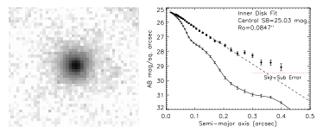
Reionization with JWST
A sum of 49 HUDF objects (dwarf galaxies) of z~6, age ~100-200 Myrs
Notes:
The picture on the left is the image sum of the 49 HUDF objects. This took 5000 hrs of Hubble and which will take 330 hrs on JWST of a single object, awesome.
The graph to the right has exponential units on the y axis.
The upper line is drawn from the image on the left. Note the deviation from the exponential at 2.5 arcsec. This deviation is interpreted as the as the radial distance for which ionization has occurred in this summed “galaxy.” This can turn off can be use to calulate and age for this object. The age calculated is ~100-200
The bottom line shows that the SB-levels that are well above those corresponding to the 3-σ limits due to PSF and sky-subtraction errors.

Slide 8
Reionization (with subtle transition to galaxy formation)
The age of summed object in the previous slide suggests that these galaxies, and thus the majority of the population II stars, formed at z = 7.5 to 6.5.
JWST will be able measure individual objects (dwarf galaxies) from z 20 to 6.
We will be able to study ionization effects from population III stars, as well as the ionization of the first galaxies.

Slide 9
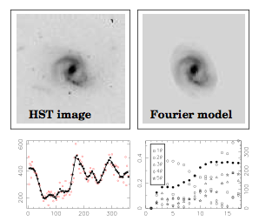
Galaxy Classification
Breaks galaxies up into concentric rings.
Terms for measuring a symmetric and antisymmetric features.
Notes:
This give us an the ability to make quantitative distinctions about the structures of galaxies.

Slide 10
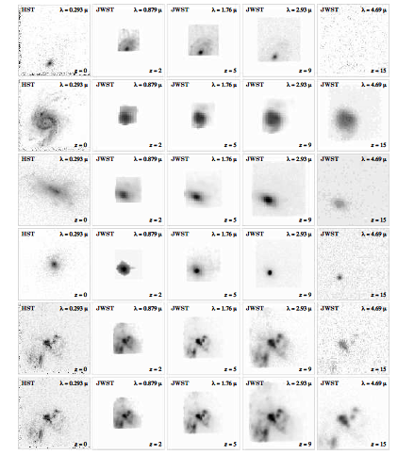
Galaxy formation
Disks are not seen at high z
AGN and Mergers are visible at high z
Probing high z lets us see galaxies as they emerge
Shorter integration time allows us to look at many such objects and calculate statistics.
Notes:
1st column is an HST image at z=0 that all subsequent columns are based on. The rows show increasing red shift.
The HST images (left column) are′′ ′′′′ ′′37or 75across, and the JWST images 0.7–3.0. Using Fourier decomposition (previous slide) we can classify the early galaxies being detected thus deep JWST surveys can measure the evolution of galaxy structure and morphology over z ≃ 15 to z ≃ 1

Slide 11
The Very First Stars: Formation and Reionization of the Universe
V. Bromm
A summery paper that shows some of the current thought on initial star formation Galaxy formation. This paper also tend to highlight Bromm’s research.

Slide 12
Motivation for Studying Feedback of the First Stars
i) The first stars give us a simplified starting point for the study of galaxy formation
ii) The initial burst of population III stars was likely to be short lived due the difficulties of forming such stars, for this reason population II stars may have dominated the early structures
iii) A subset of population II stars, with masses less than 1 solar mass still exist today, these stars can be used to constrain simulations that predict the chemical abundances in population II stars and subsequent generations.
Notes:
This paper start out with these motivations for the study of the Feedback processes for the formation of the first stars.
Is mentioned as one of the main outstanding questions in cosmology.
iii) These stars can give us information, indirectly, about population III stars.
It is mentioned that JWST will probe stars and quasars less than one billion years after the big bang z greater then 6.

Slide 13
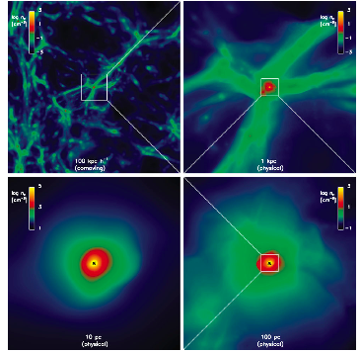
Primordial Star Formation
First stars formed when gas was able to cool and form structures in dark matter mini-halos
Called population III.1
The mini-halos (of dark matter) have a mass of 10⁶ solar masses
Notes:
The fist bullet happen, according to the paper a couple Million years after the big band, so like z=10 to 30.
The physical scales are labeled in the graph and become successively smaller.
The asterisk in the lower two panels denote the location of the sink where matter begins to collect.
Up top we can see the dark mater mini halo’s.

Slide 14
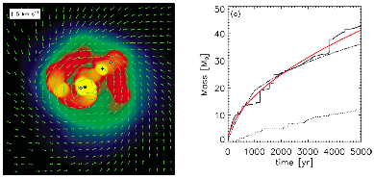
Primordial Star Formation
Definition: Population III.2 – Where metal-free gas become ionized just prior to runaway gravitational collapse
For both cases, collapse forms a protostellar core with an accreting disk
Simulations with realistic cosmological initial conditions indicate that these stars may form multi-star systems.
Notes:
It is mentioned for bullet point two that this process might not be quite different from how we think of modern star formation.
Right panel is a velocity field over a density distribution in a dark matter min halo. Asterisk is the most mass massive sink. Cross is the second most massive sink other sinks are marked by yellow dots. Shown here is 5000 years after the initial sink formation.
The solid line is the largest sink in this model. Dot dash line is an accretion history found in an earlier paper. Red line is M = t^(0.55). The lower dotted line is the mass history of the second largest sink.
The author admits that a 3-D model of the same initial conditions need to be employed to validate these results.

Slide 15
More Primordial Star formation
Population III.1 stars rely on H₂ cooling, but population III.2 stars may be cooled down to 200K by HD leading to formation of 10 solar mass stars!
This occurs in ionized regions since electrons aid in molecule formation.
The ionized regions are the product of space ionized by; population III.1 stars, supernova shocks, virialization of massive dark matter halos.
Notes:
HD= Hydrogen deuterium molecule. Clouds can be optically thinner in the HD emission bands.
Virial as in Virial Theorem.

Slide 16
Formation of the First Galaxies
These galaxies form in dark matter halos of 10⁸ solar masses
This mass is require to retain photoheated gas
Atomic cooling translates gravitational potential into turbulent motions on the galactic scale, which, move the gas inward to the galactic halo
Hot accretion is when gas is accreted from the IGM and is heated to the virial temperature
This method of gas transport dominates low mass galaxies at high red shift.
Notes:
The large dark matter halos that formed in bullet one are thought to occur around z = 10.
Recall that the mini-halos required for population III star formation were 10^6 solar masses.
Third bullet point: The turbulent motions are the perturbations the form the sinks need to form stars.
Gas from the IGM, funny to call it IGM at this point, is accreted and heated to the virial temperature. This is the main channel of gas accretion until cooling in filaments becomes important.

Slide 17
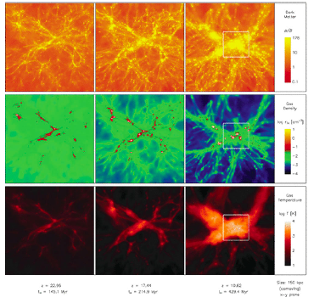
Formation of the First Galaxies
Another mode of accretion, called cool accretion, dominates when filaments of gas are massive enough for molecule formation
In these filaments cooling is more efficient and then the cooled gas aslo flows into the galactic halo
Notes:
The graph to the left shows the first type of accretion hot accretion.
Top row dark matter assembly.
and pristine gas (middle row) into a primordial galaxy. Shown is the evolution at three different stages (from left to right). White crosses indicate individual Pop III stars, which form prior to the first galaxy. The assembly process is accompanied by powerful virialization shocks that heat up the infalling gas to > 104 K (bottom row).

Slide 18
Why Galaxy Formation is Complicated
The history and end products of the first stars need to be understood
High energy partials and photons from the first supernova complicate the equation of state
Turbulent fluid motions due to accretion from the IGM
Magnetic Fields
Good luck with that.
Hopefully observations from JWST will enable you to constrain the theory and put you on the correct path.
Notes:
Metal makes cooling far more efficient since the optical depth of metal and thus the escape time is for photon is much less then Hydrogen.

Slide 19
fin

